Slide 1
The Hardware-in-the-loop Testbed for Microgrid
Jun Zhang
Graduate Research Assistant
Electrical Engineering & Computer Science
Daktronics Engineering Hall 314

Slide 2
Why HIL?
HIL Simulation: validate a control system's design by running the control on its actual hardware
 | HIL | Software Simulation
Synchronization | Not guarantee (fit reality) | Always guarantee
Communication | Real protocol with delay(fit reality) | No protocol and virtual delay
Measurement | Real sensors with bias, error and delay (fit reality) | Virtual sensor
Simulation speed | Real time (fit reality) | Virtual time (slow)
Cost-efficiency | Low | High
HIL is closer to reality

Slide 3
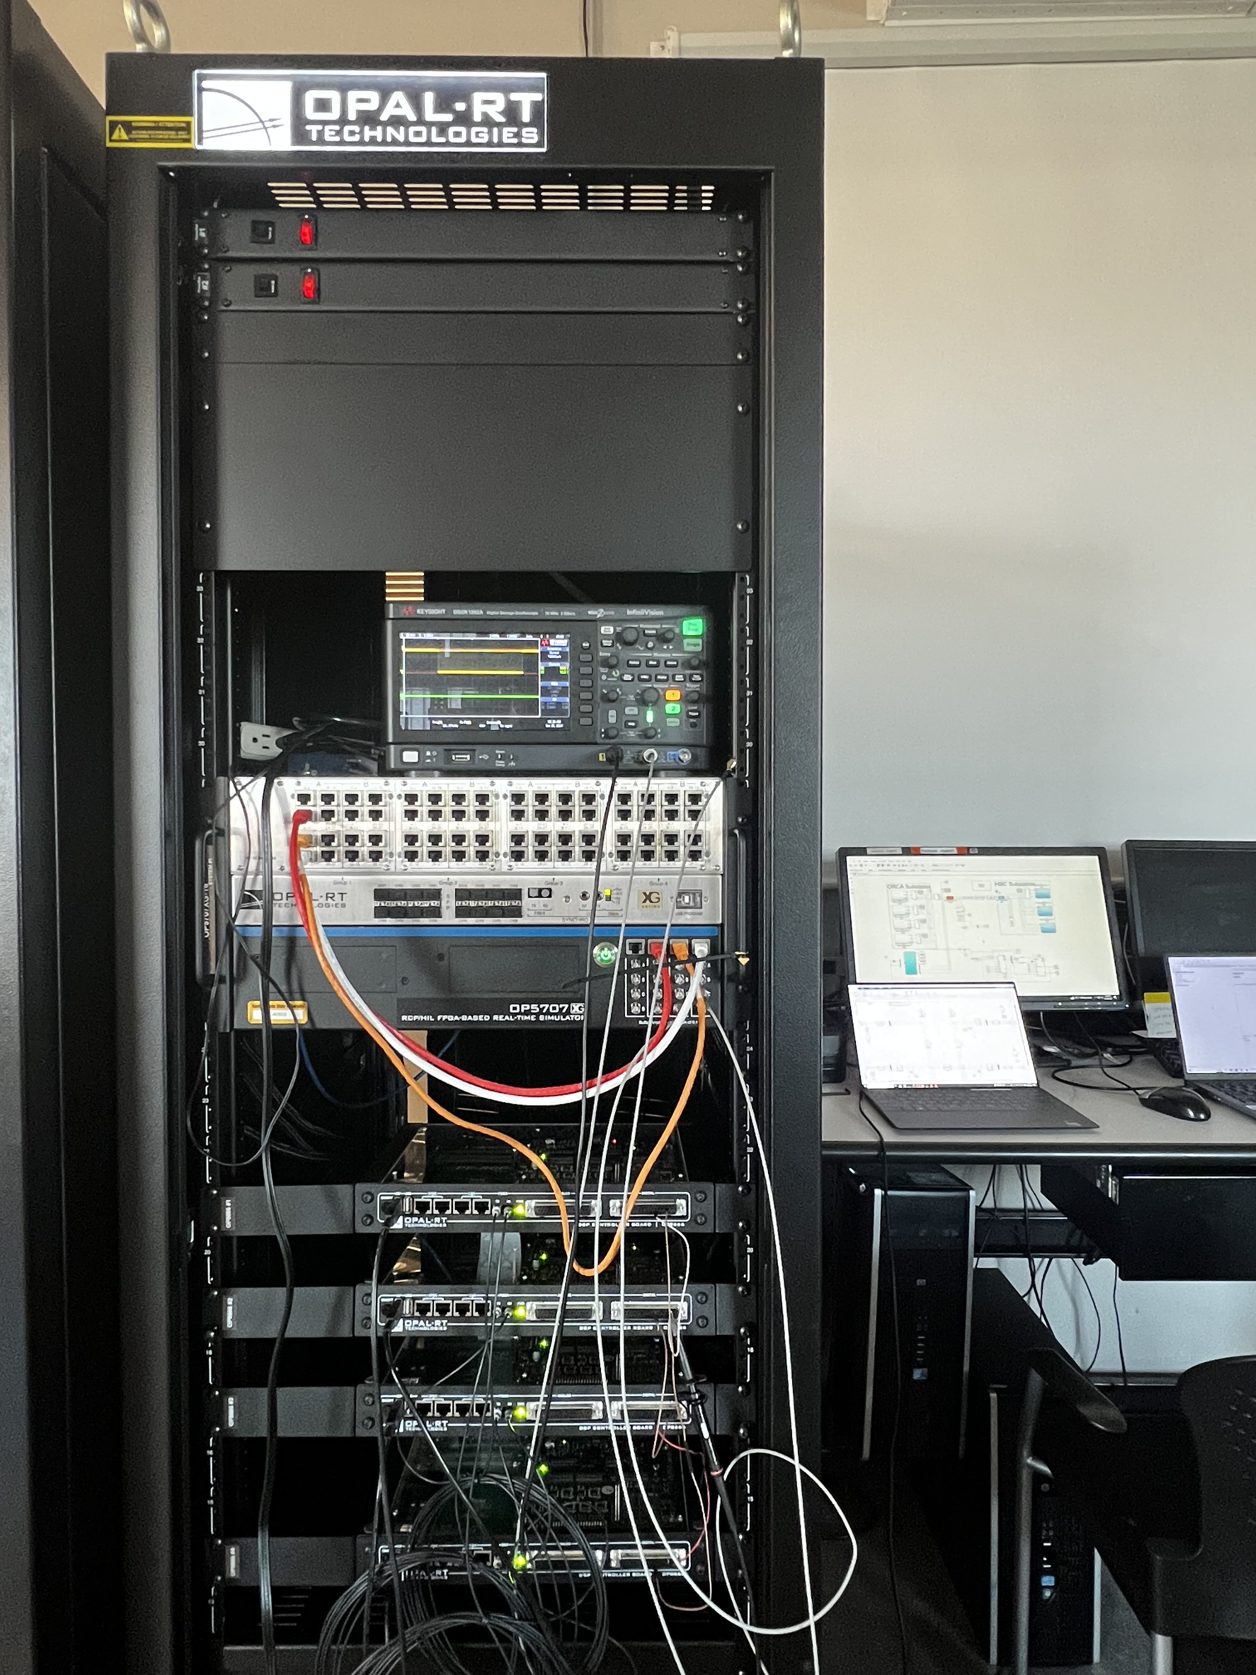
Testbed structure
System data flow
Testbed overview
Simulator: model the inverters, measurements, and the power grid in real time
OP8666: DSP controller
Monitor and Oscilloscope: Data monitoring

Slide 4
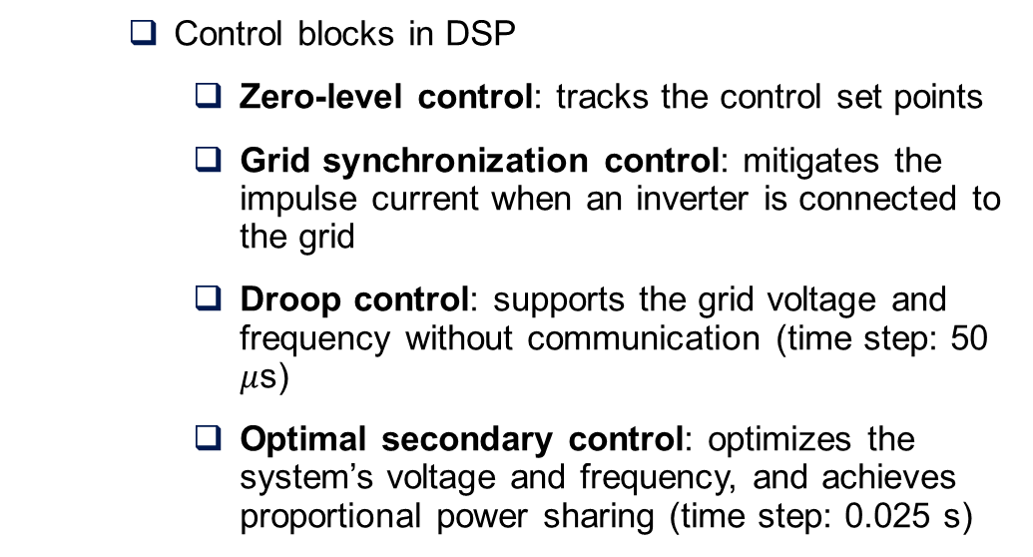
Control Structure
Control blocks in DSP
Zero-level control: tracks the control set points
Grid synchronization control: mitigates the impulse current when an inverter is connected to the grid
Droop control: supports the grid voltage and frequency without communication (time step: 50 $μ$s)
Optimal secondary control: optimizes the system’s voltage and frequency, and achieves proportional power sharing (time step: 0.025 s)

Slide 5
Communication & cores ASSIGNMENT
Communication
Bidirected communication: use two set of transmitter and receiver to have bidirected communication.
Time step: 0.025s
Cores assignment
Core1: primary control, secondary control and clockwise communication
Core2: counterclockwise communication
Communication between core1 and core2 by global RAM
Global RAM
Primary Control
Secondary Control
Serial
Communication 1
Serial
Communication 2
core1
core2

Slide 6
Simulation result
System under droop mode
1. Black start in droop mode:
Inverter 1 black starts
Inverters 2,3, and 4 plugin
Load changes
1
2
3
4
5
1
2
3
4
5
1
2
3
4
5

Slide 7
Simulation result
System under optimal control
2. Switch to optimal control:
Running in droop mode
Mode change
Load changes
1
2
3
1
2
3
Restore the frequency to 60 Hz
Admissible voltage profile

Slide 8
Simulation result
2.Shift to the proposed control:
Running in droop mode
Mode change
Load changes
1
2
3
1
2
3
Better reactive power sharing
Perfect active power sharing

Slide 9
Q & A
Thanks for your listening!

